Slide 1



Aqua Marketing Plan
Here is where your presentation begins

Slide 2


Table of Contents
About Us
Market Analysis
Goals & Strategy
01
02
03
Content Plan
Budget
KPI Overview
04
05
06
Here you could describe the topic of the section
Here you could describe the topic of the section
Here you could describe the topic of the section
Here you could describe the topic of the section
Here you could describe the topic of the section
Here you could describe the topic of the section

Slide 3
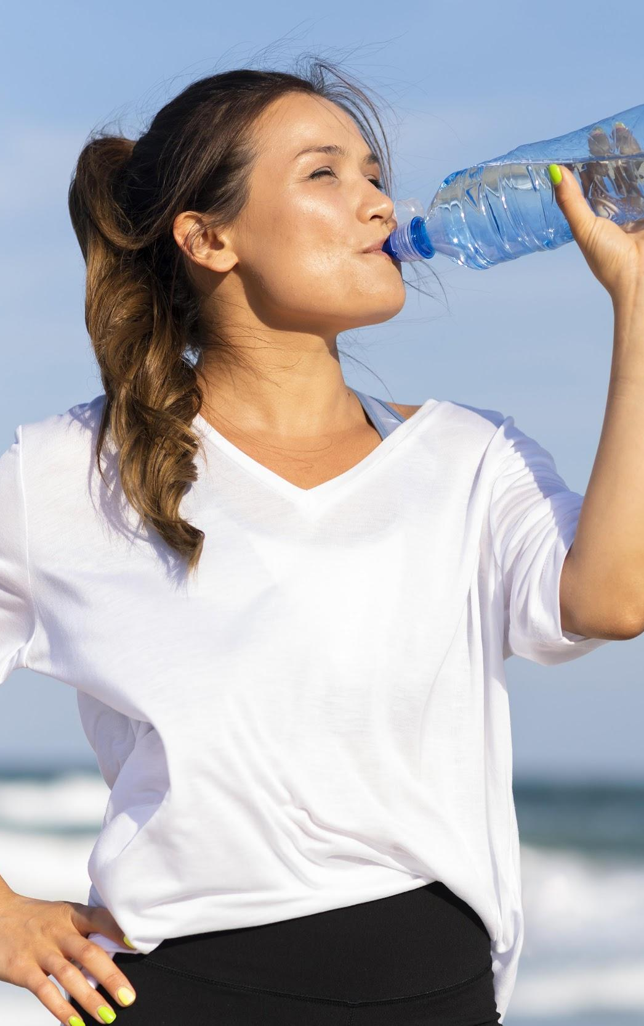
Introduction
Mercury is the closest planet to the Sun and the smallest one in the Solar System—it’s only a bit larger than the Moon

Slide 4
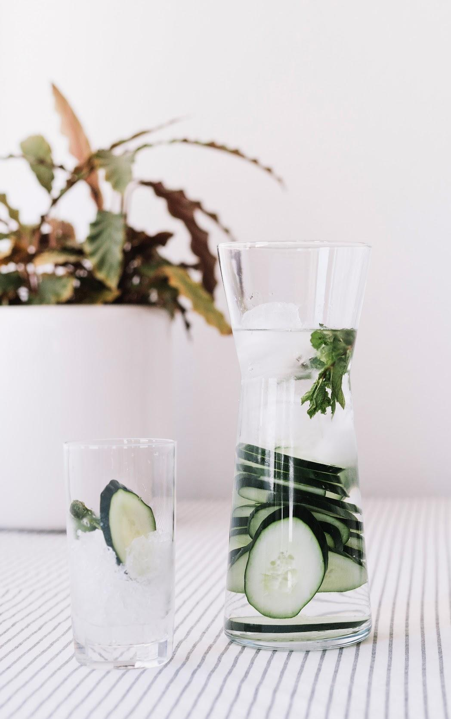
About the Product
Mercury is the closest planet to the Sun and the smallest one in the Solar System—it’s only a bit larger than the Moon

Slide 5
01
About Us
You can enter a subtitle here if you need it

Slide 6


Our evolution
2017
2018
2019
2020
Mercury
Venus
Jupiter
Saturn
It’s the smallest and innermost planet in the Solar System
It has a beautiful name, but also very high temperatures
It’s the fifth planet from the Sun and the largest
It’s the sixth planet from the Sun and the second-largest

Slide 7
What Sets Us Apart?
100%
organic
A critical
mission
Trusted
partnership
Venus has a beautiful name, but also a poisonous atmosphere
It’s the smallest and innermost planet in the Solar System
It’s the sixth planet from the Sun and the second-largest

Slide 8
—SOMEONE FAMOUS
“This is a quote, words full of wisdom that someone important said and can make the reader get inspired.”

Slide 9


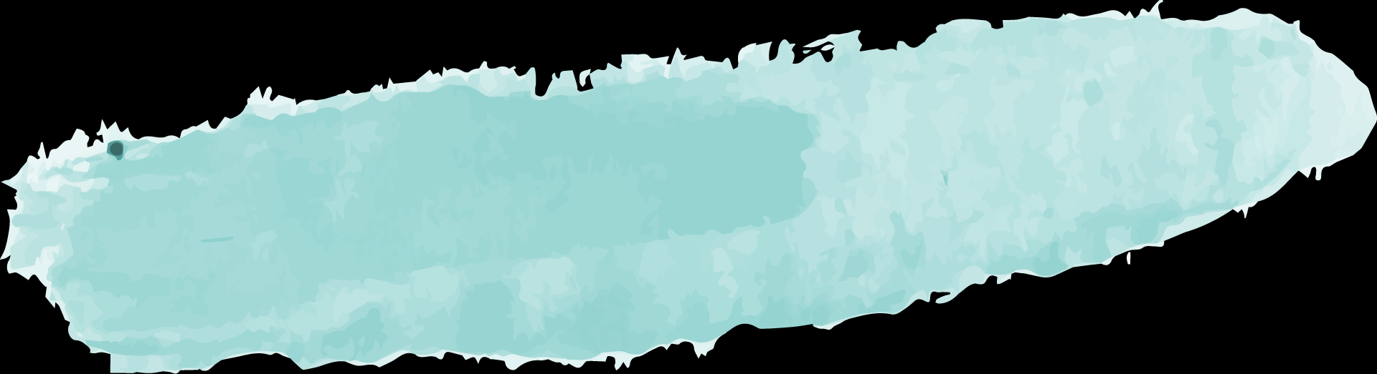
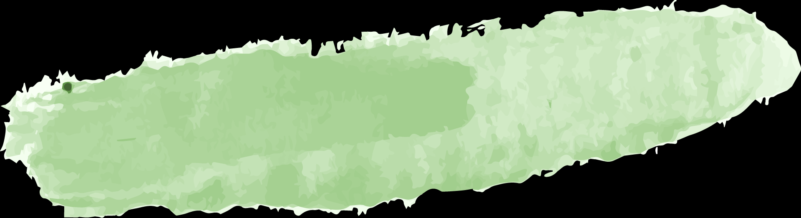
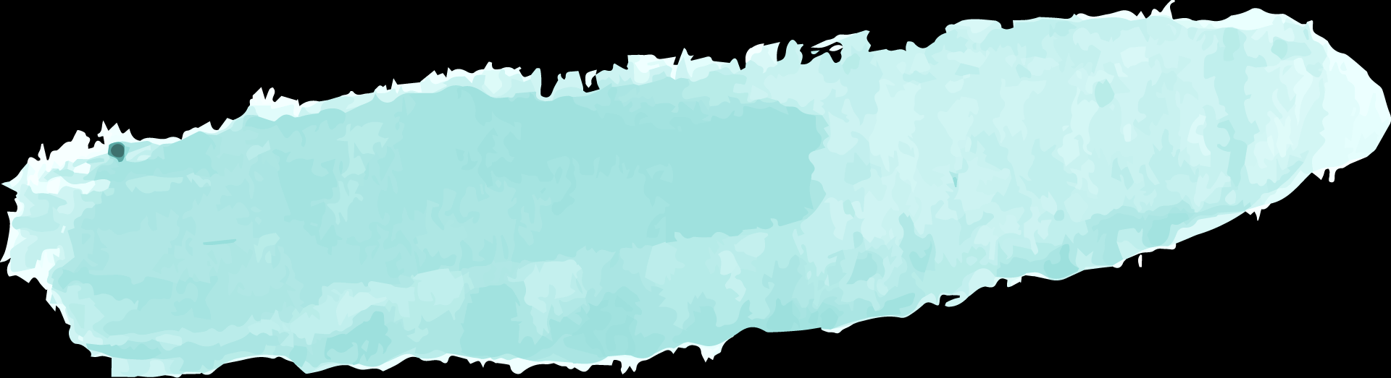

Buyer Persona
Skills:
Influences
Internet
Venus has a beautiful name
Software
Social
Angelina Doe
Must Do
Frequency
Despite being red, Mars is a cold place
Earth is the third planet from the Sun
Age: 35
Occupation: IT
Education: University
Personality: Extrovert
Must Never
Relationship
Saturn is a gas giant and has rings
Mercury is the smallest planet

Slide 10
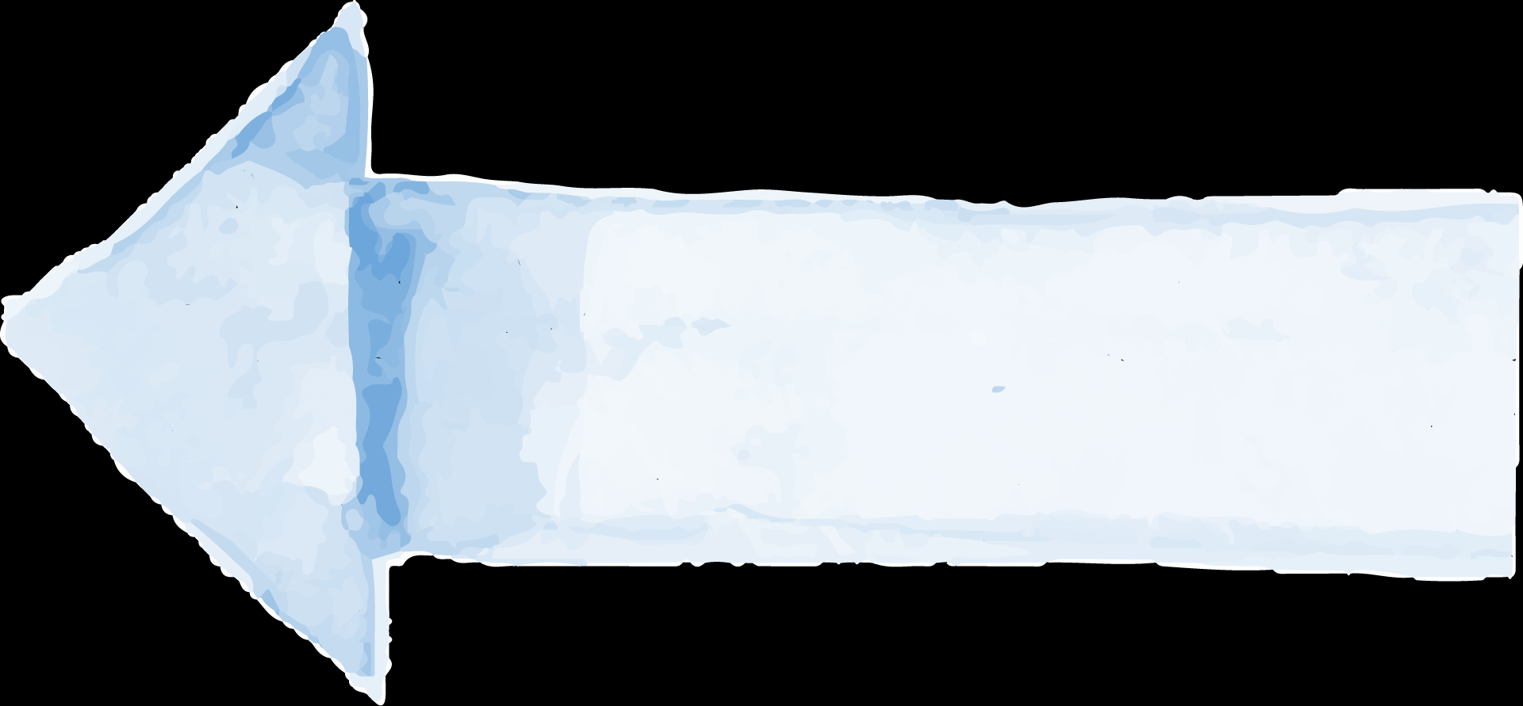
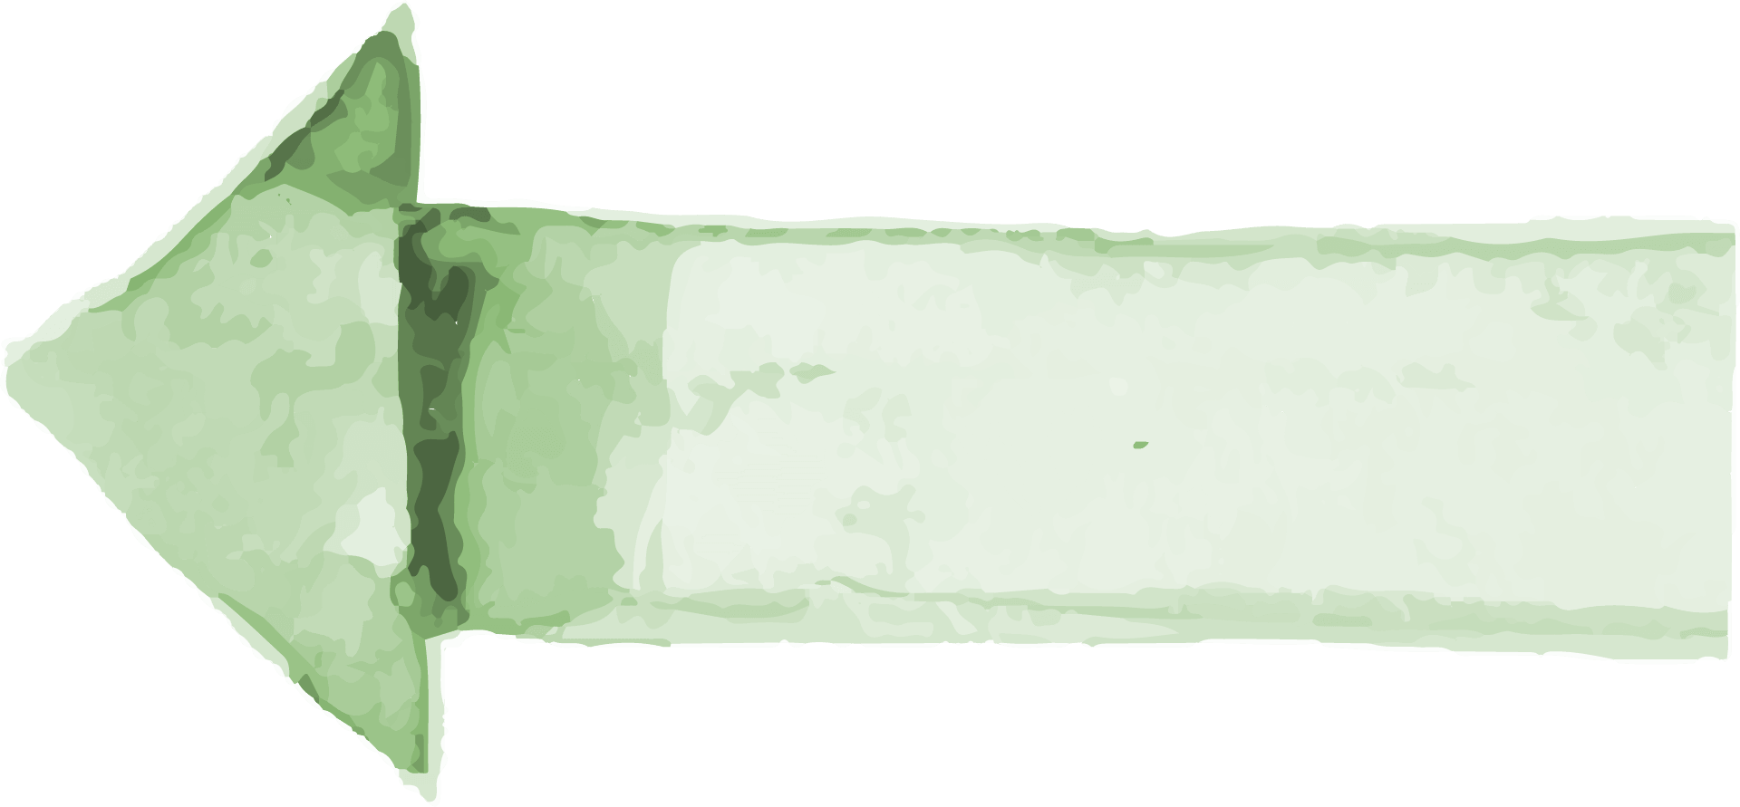
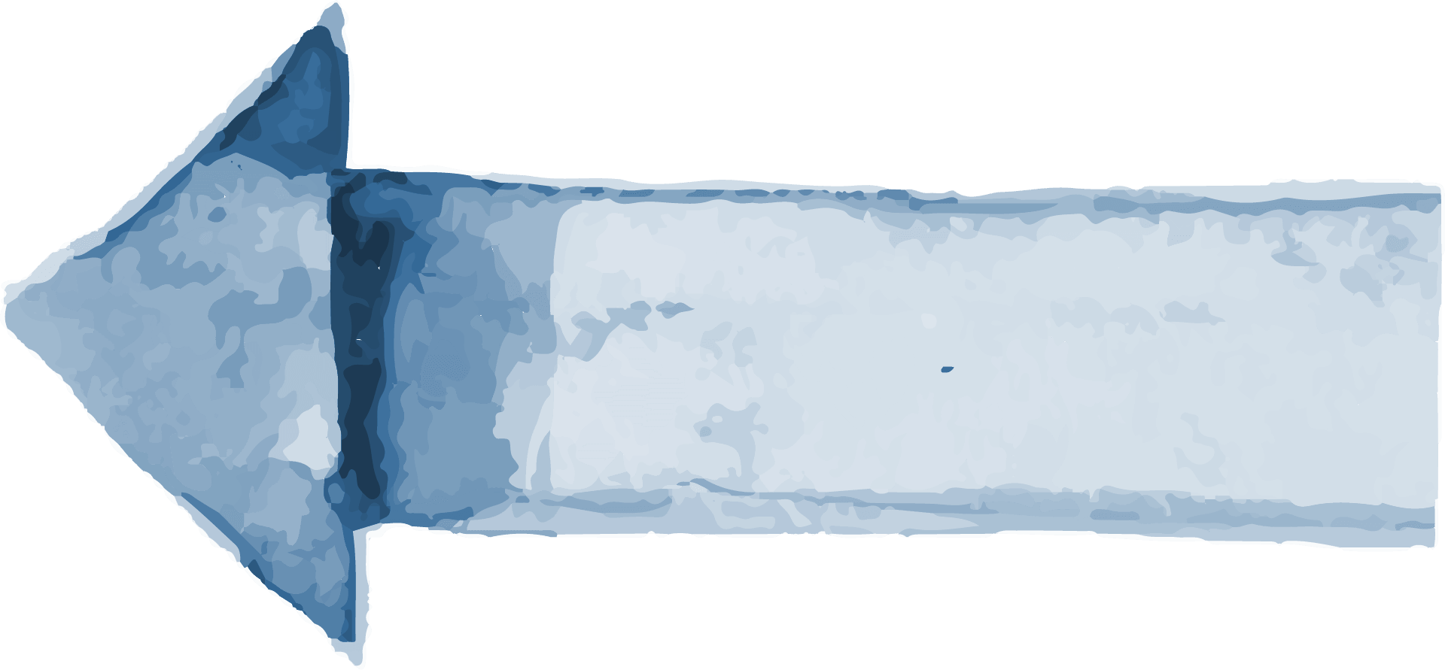
Buyer Journey
01
02
03
Awareness
Consideration
Decision
Mercury is the closest planet to the Sun
Despite being red, Mars is a cold place
Jupiter is a gas giant and the biggest planet

Slide 11
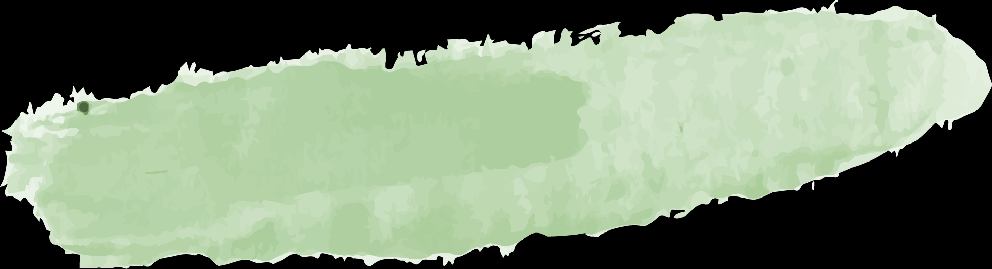
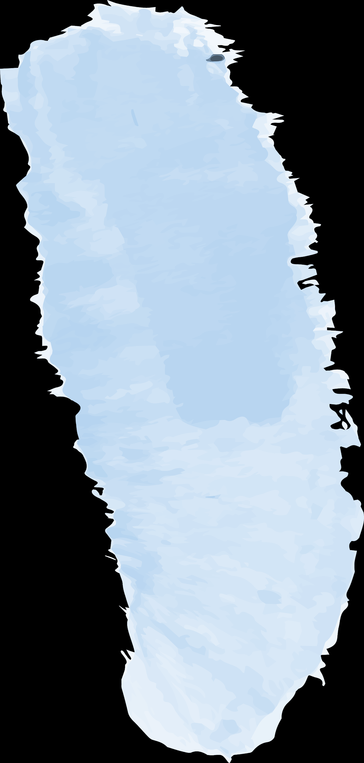
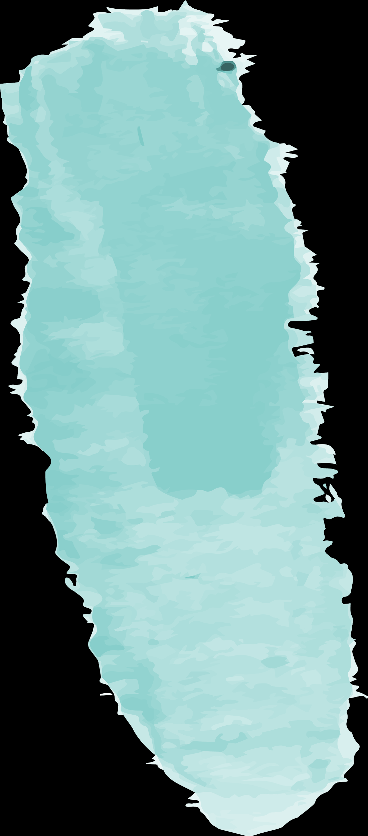

Sales Funnel
01
Awareness
Mercury is the closest planet to the Sun
02
Interest
It’s a gas giant and has several rings
03
Decision
It’s the closest planet to the Sun
04
Purchase
Despite being red, Mars is a cold place

Slide 12
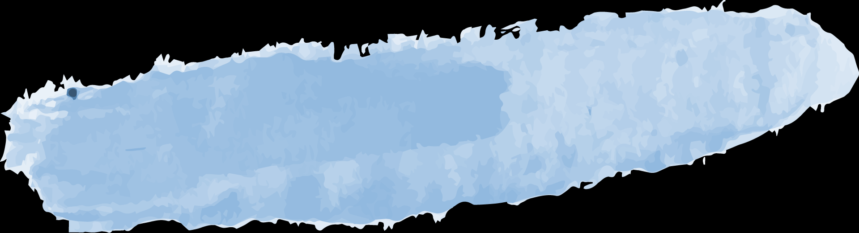
Competitor Analysis
20%
10%
50%
25%
Mercury
Mars
Venus
Jupiter
It’s the closest planet to the Sun
Despite being red, Mars is a cold place
Venus has a beautiful name
A gas giant and the biggest planet

Slide 13
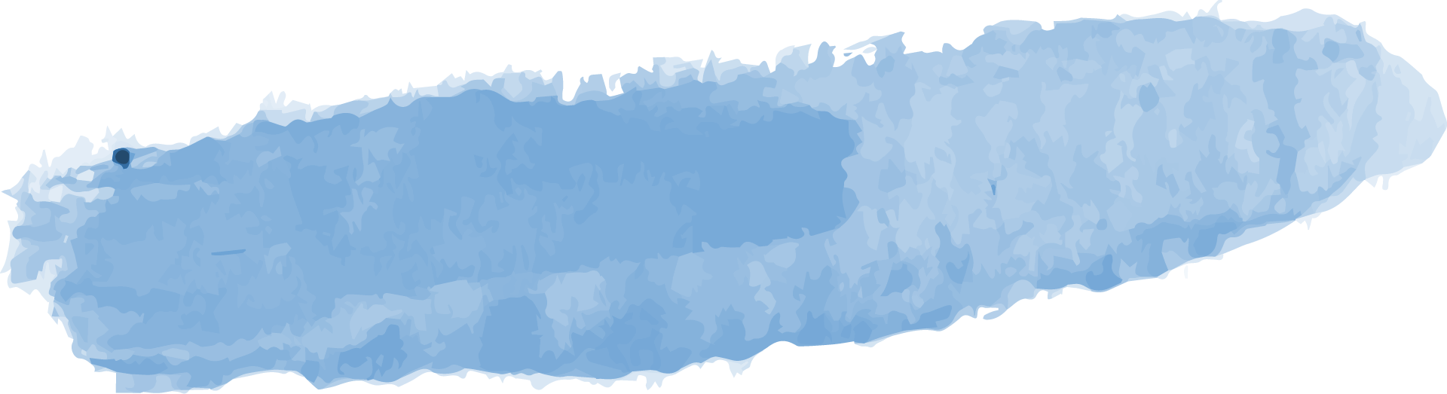
SWOT Analysis
Strengths
Weaknesses
Opportunities
Threats
Venus is the second planet from the Sun. It is named after a Roman goddess
Mercury is the smallest and innermost planet in the entire Solar System
Saturn is the sixth planet from the Sun and the second-largest in the Solar System
Jupiter is the fifth planet from the Sun and the largest in the Solar System

Slide 14
Our SWOT Analysis
Weaknesses
Opportunities
Strengths
Jupiter is the biggest planet in the entire Solar System
Neptune is the farthest planet from the Sun
Threats
Despite being red, Mars is actually a very cold place
Saturn is composed mostly of hydrogen and helium

Slide 15

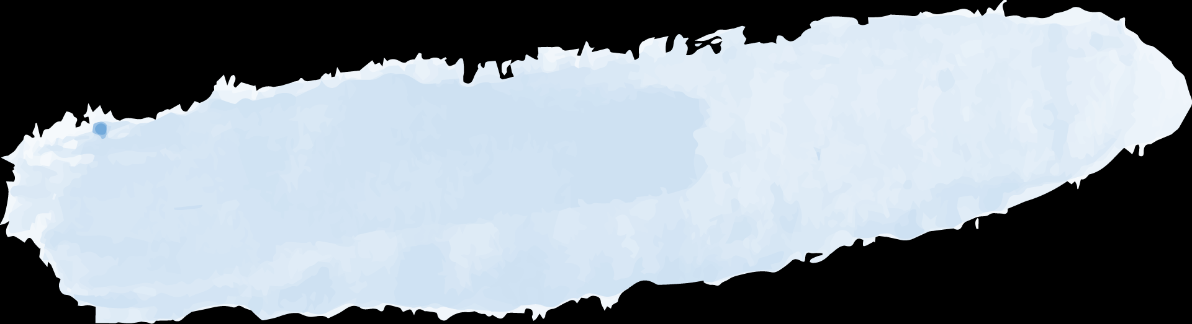
Goals
Goal 1
Goal 3
Goal 2
Goal 4
Venus has a beautiful name, but also very high temperatures
Jupiter is a gas giant and the largest planet in the Solar System
Saturn is composed mostly of hydrogen and helium
Mercury is the smallest and innermost planet in the Solar System

Slide 16
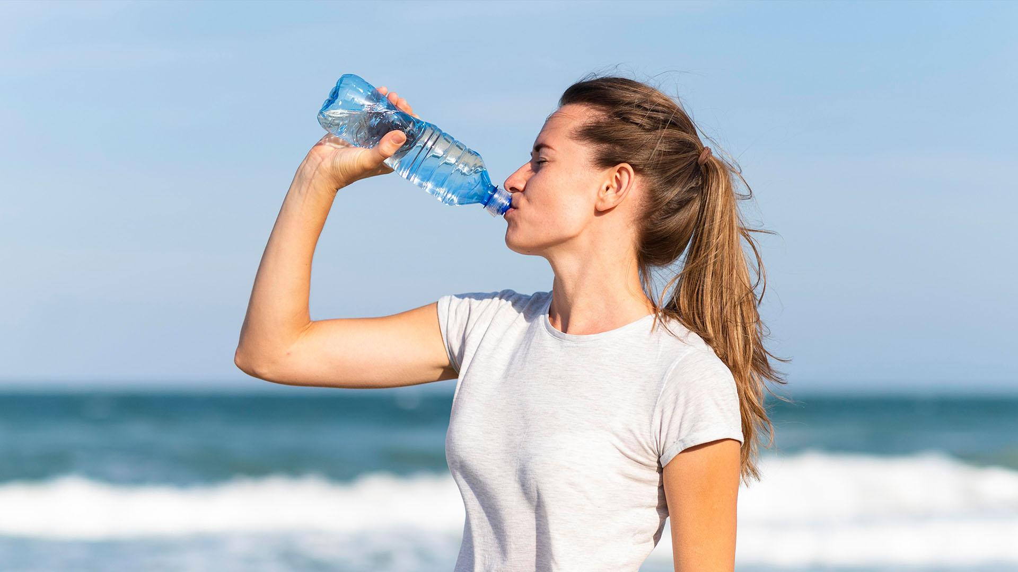
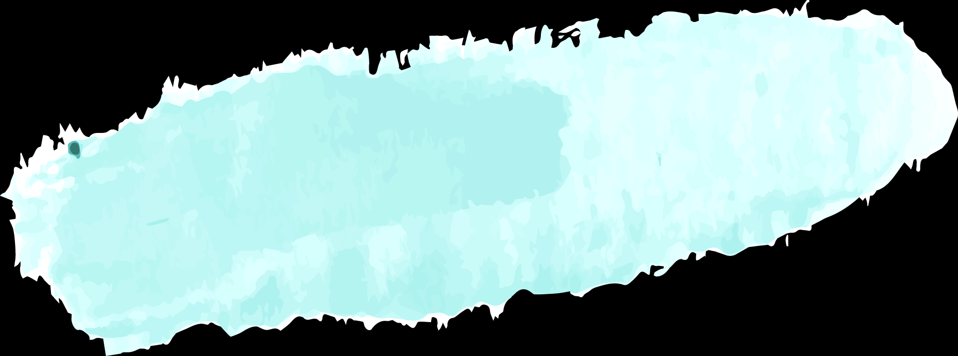
A Picture Is Worth a Thousand Words

Slide 17
Strategy
Key Action 1
Mars
Goals
Key Action 2
Saturn
Neptune is far away from Earth
Despite being red, Mars is cold
It is named after a Roman goddess
Earth is where we all live on
It’s a gas giant and has several rings

Slide 18
Key Action Items
 | First Quarter | Second Quarter | Third Quarter
Key Action 1 | Here you can describe your items for the quarter | Here you can describe your items for the quarter | Here you can describe your items for the quarter
Key Action 2 | Here you can describe your items for the quarter | Here you can describe your items for the quarter | Here you can describe your items for the quarter
Key Action 3 | Here you can describe your items for the quarter | Here you can describe your items for the quarter | Here you can describe your items for the quarter

Slide 19
Timeline
Mars
Jupiter
Saturn
Despite being red, Mars is cold
It’s the biggest planet of them all
Saturn is the sixth planet from the Sun
Mercury
Neptune
It’s the closest planet to the Sun
It’s the farthest planet from the Sun

Slide 20
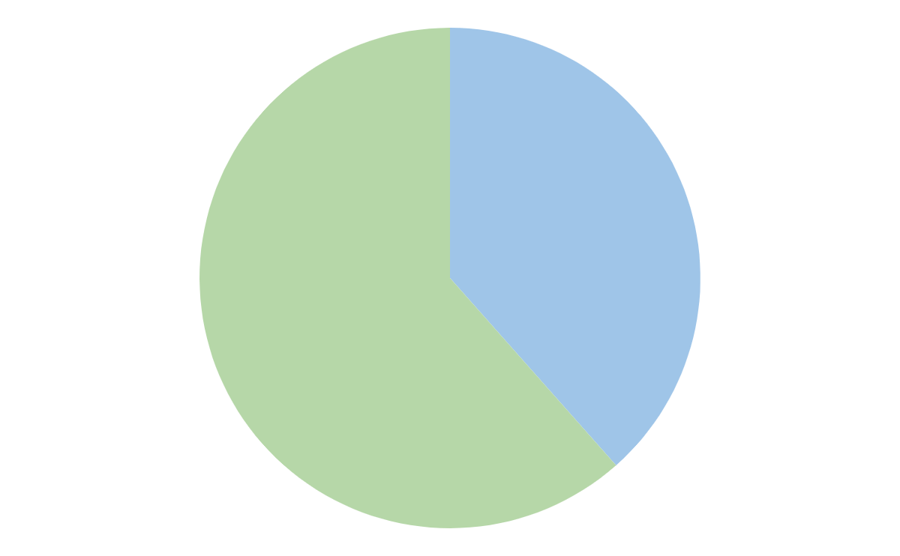
Budget
Jupiter
40%
Neptune
Jupiter is a gas giant and the biggest planet in the Solar System
Neptune is the fourth-largest planet in the Solar System
60%
To modify this graph, click on it, follow the link, change the data and paste the new graph here

Slide 21
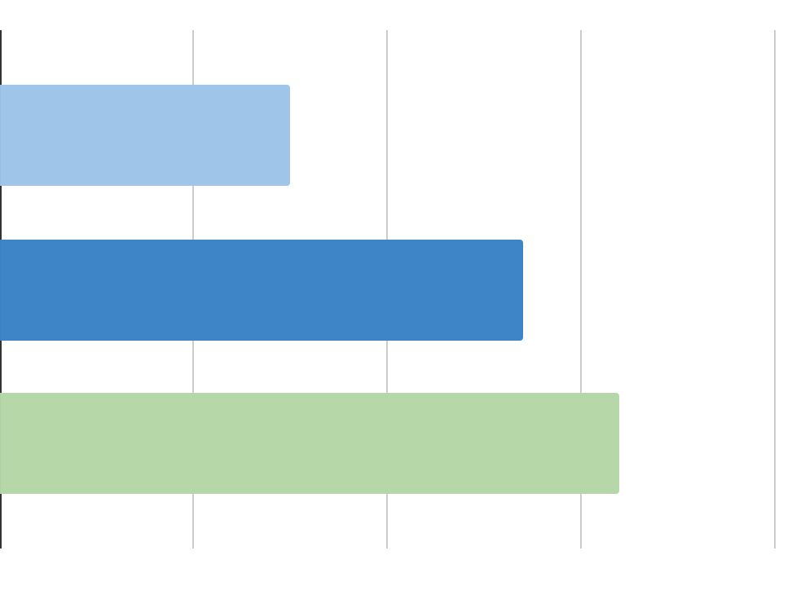
KPI Overview
25%
50%
Paid Search
€1.5
Organic Search
€2.7
Jupiter
Venus
A gas giant and the biggest planet
Planet Venus has a beautiful name
Referral
€3.2
Productivity
CPC by traffic
To modify this graph, click on it, follow the link, change the data and paste the new graph here

Slide 22




Our Team
David James
Keanu Doe
You can replace the image on the screen with your own
You can replace the image on the screen with your own

Slide 23
Project Vision
Deliver Value
Guiding Principles
Effective Efficiency
Teamwork
Venus has a beautiful name, but also a poisonous atmosphere
The second planet from the Sun. It is named after a Roman goddess
The fifth planet from the Sun and the largest in the Solar System
Saturn is the sixth planet from the Sun and the second-largest

Slide 24
Awesome Words

Slide 25

Maybe You Need More Columns
Venus
Mercury
Saturn
Jupiter
Mars
Earth
Planet Venus has a beautiful name
It’s the closest planet to the Sun
It’s composed of hydrogen and helium
It’s the biggest planet in the Solar System
Despite being red, Mars is a cold place
It’s the third planet from the Sun

Slide 26
3,235.00
Big numbers catch your audience's attention

Slide 27
Active Marketing List
Accessory Buyers: Venus has a beautiful name, but also high temperatures
Bloggers: Mercury is the smallest and innermost planet in the Solar System
Computer Buyers: Saturn is the sixth planet from the Sun and the second-largest
Current Customers: Jupiter is the biggest planet in the entire Solar System
Home Appliance Buyers: Neptune is the farthest planet from the Sun
Online Reviewers: Earth is the third planet from the Sun and where we all live on

Slide 28
Map
Venus
Planet Venus has a beautiful name
Mars
Despite being red, Mars is a cold place

Slide 29

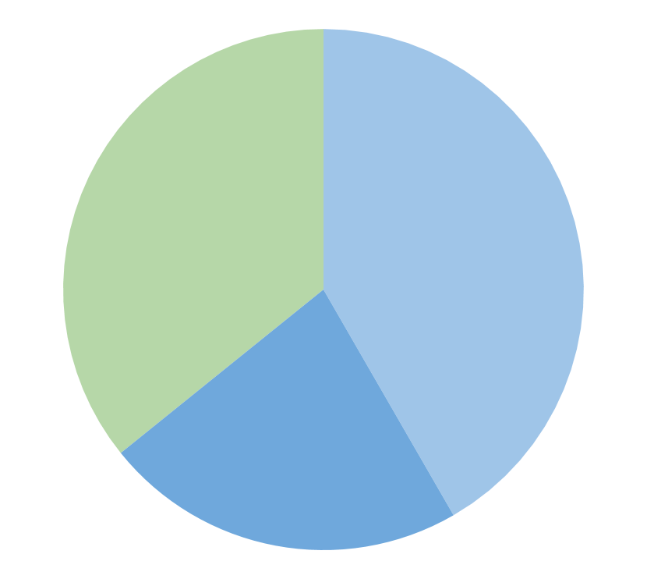

Market Share
Venus
Planet Venus has a beautiful name
Saturn
Mars
859
1000
To modify this graph, click on it, follow the link, change the data and paste the new graph here
Despite being red, Mars is a cold place
Jupiter
541
It’s a gas giant and the biggest planet

